Slide 1

Dev & Build Process Design Release v2 September 2020
Allen Coates
Rob Kent
Rachel Liu

Slide 2
Agenda
Current process summary & baselining – as is
Existing workflow wireframing & baselining – as is
Highlight opportunities for optimisation
Target state design – to be
Target state workflow wireframing – to be
Key recommendations
Bridging the gap between Jira & ServiceNow
Benefits
Next Steps
Additional requirement

Slide 3
Dev’s .NET MSI Daily Build Release – Current Process Summary & Baselining As-Is
Coding: JIRA flow update, GitHub fork/branch, ReSharper/SonarQube static code analysis
Depending on the team, forking or feature branch might be used on Git.
SonarQube is available in dev environment only and is currently not integrated into GoCD pipeline.
Unit Testing: GoCD
Git webhooks into GoCD or GoCD polls into Git to trigger a local build
GoCD is integrated with both Fortify and Selenium as part of unit testing
Build/MSI Packaging (41 steps in total): CC Tray/InstallShield package build, AI Selection/AI Action install build
Highly manual process to prepare for build, package build and install build package.
Requires the use of RDP
CC Tray is used to package MSI components for build release or InstallShield for making menu changes
AI Selection/Action is used to install build package and store config.
Release Handover: Excel/ServiceNow
Deployment to ST: AI Action/GoCD

Slide 4
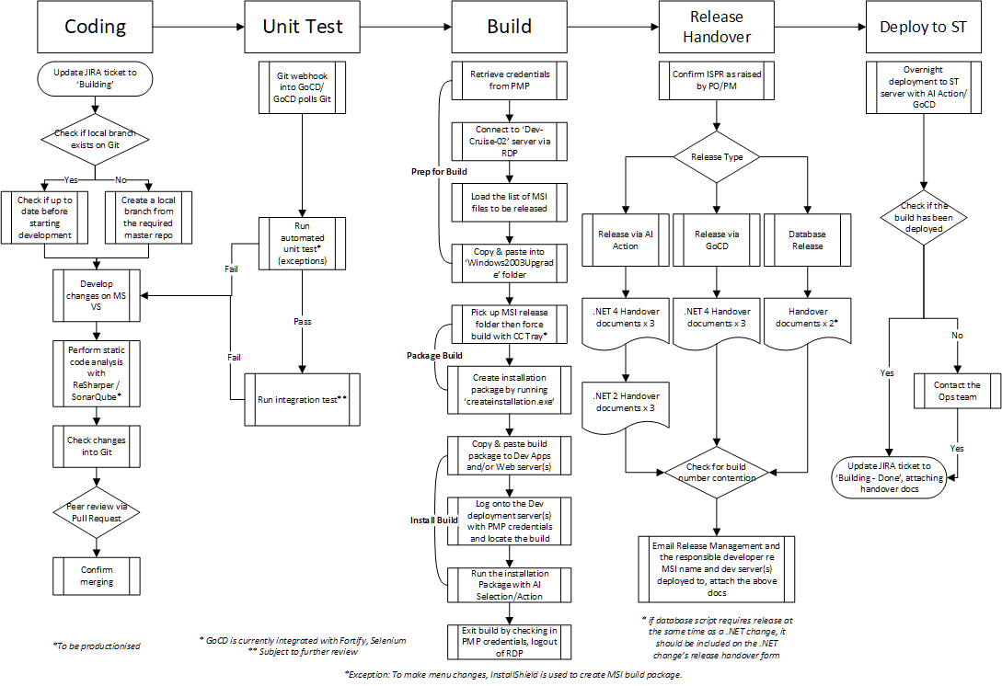
Existing Workflow Wireframing & Baselining As-Is

Slide 5
Highlight Opportunities for Optimisation

Slide 6
Target State Workflow Wireframing To-Be

Slide 7
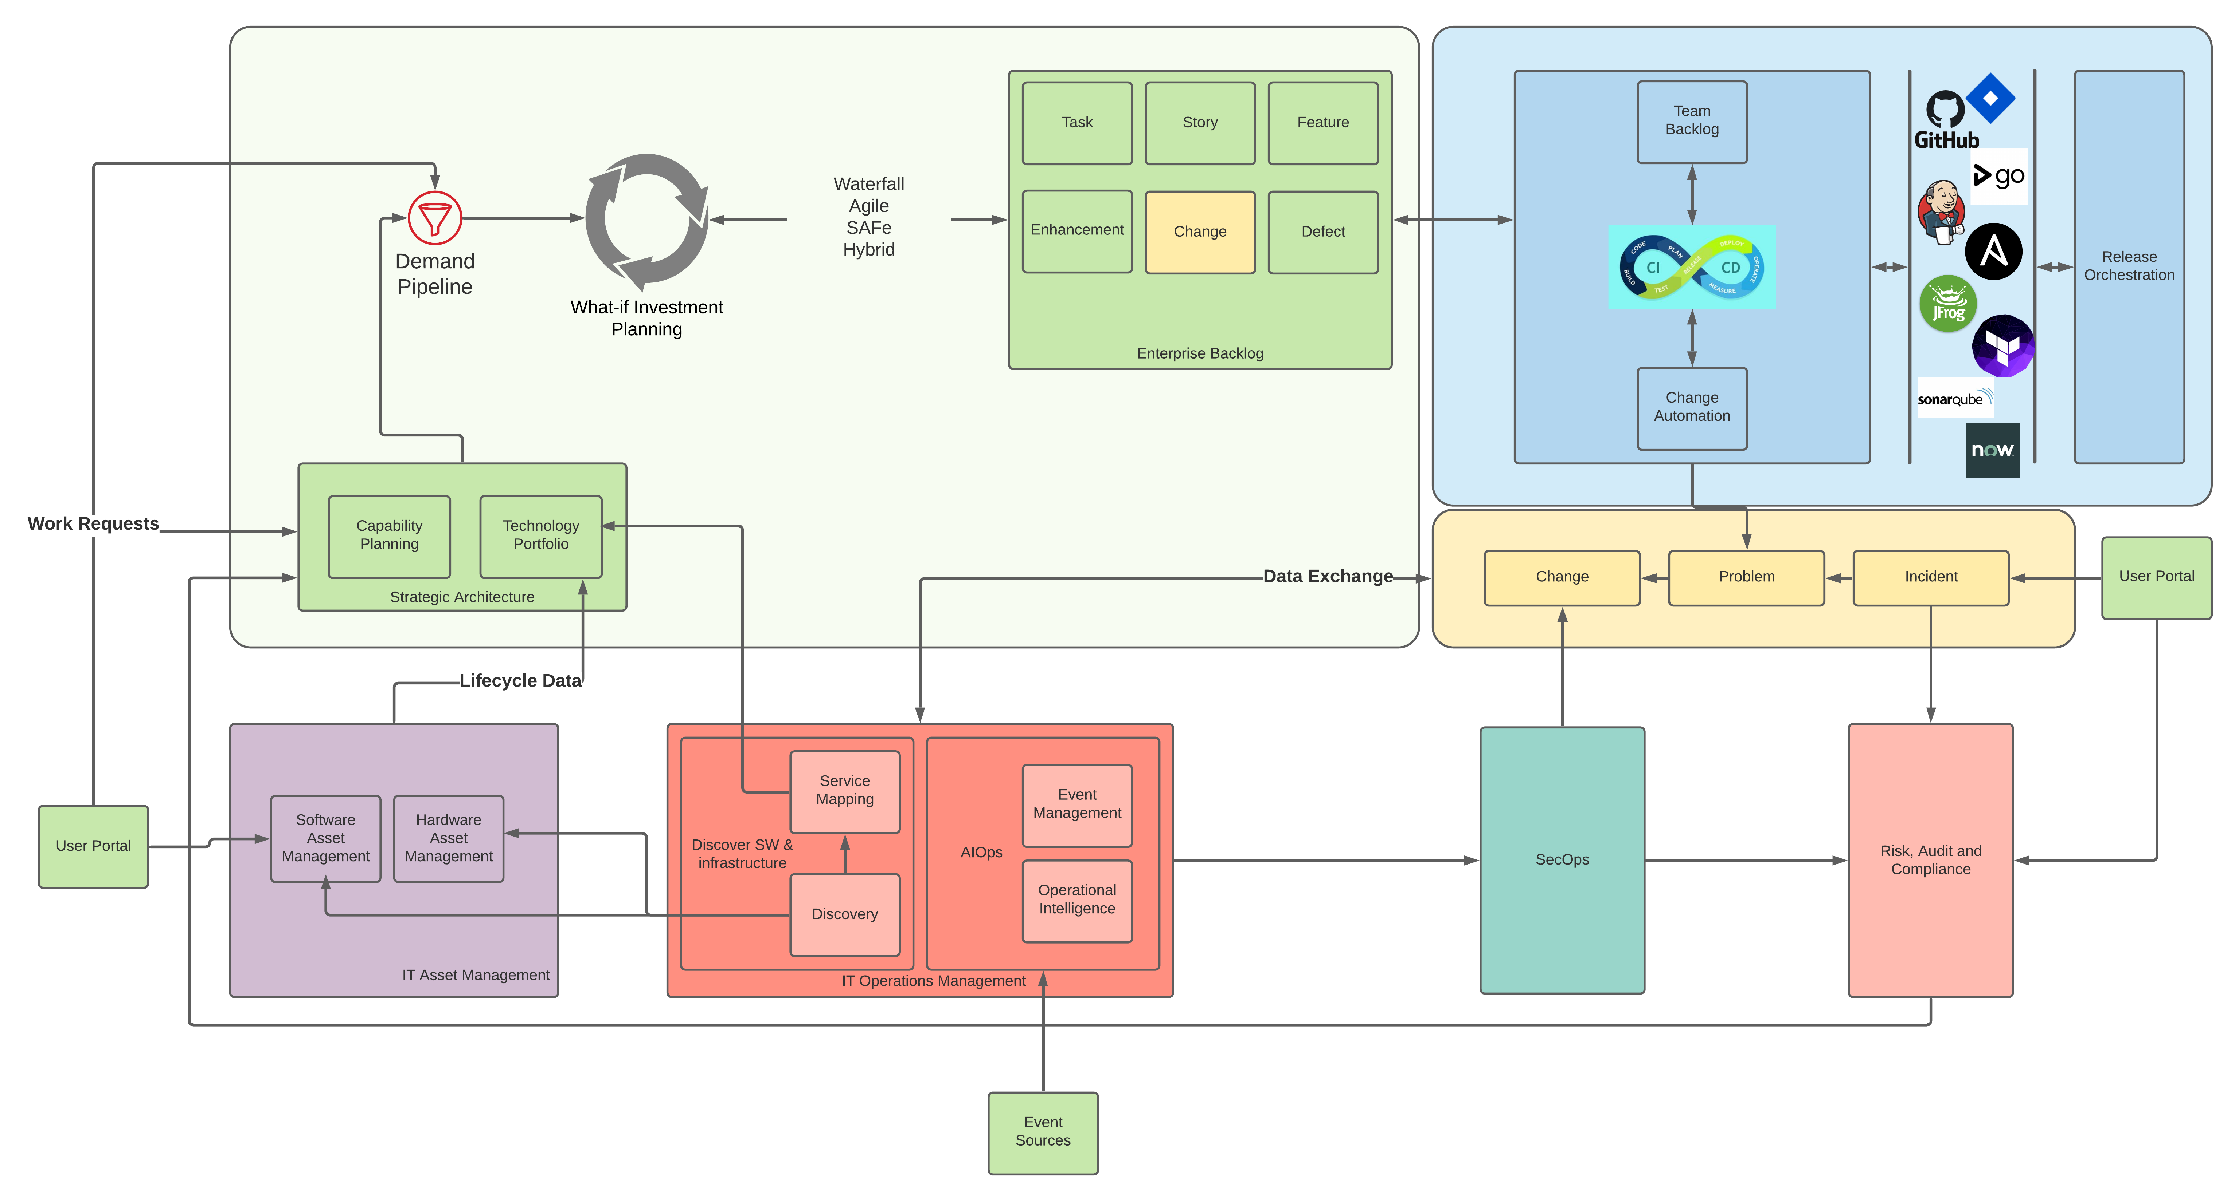
Enterprise View SDLC as part of Plan > Build > Run > Service involving multiple process considerations

Slide 8
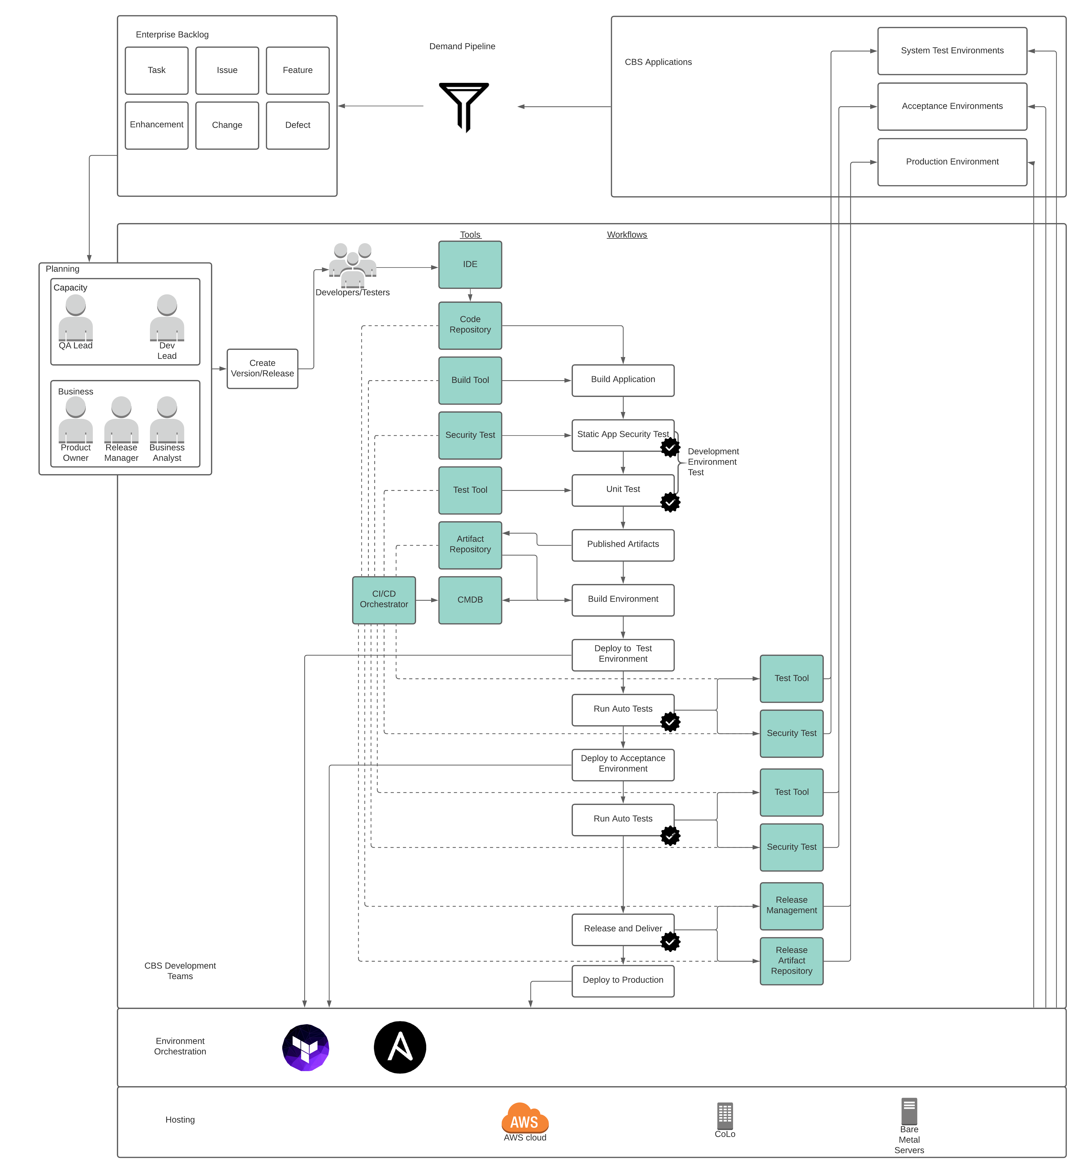
High Level Reference Architecture To-be
Overview:
Release planning at the start of the process
Discover failures early by testing locally
Single build artifact deployed across each environment – no build per environment
Deployment across multiple environments on a single pipeline by passing configuration to the environment
Automated quality gates to build confidence in code
Leverage pipeline metadata to automate Change Control and Deployments via Release Orchestraion

Slide 9
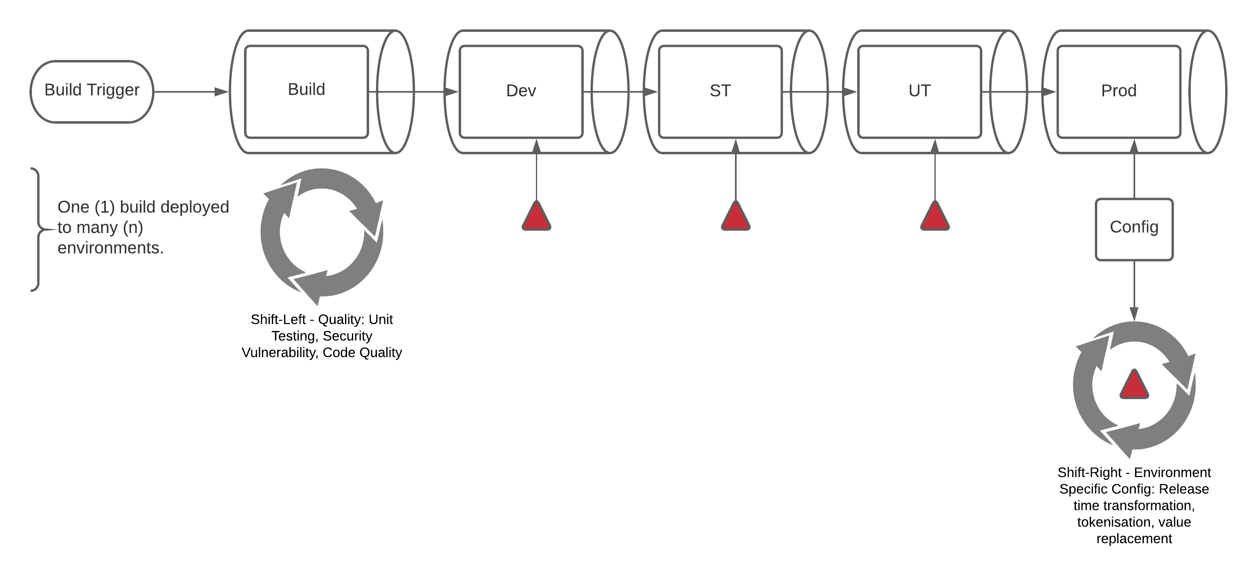
Shift Quality Left, Shift Config Right Future CI/CD View – Quality feedback moves towards the developer, environment specific configuration moves towards the target

Slide 10
Bridge the Gap: Jira – ServiceNow
Recommendations:
Linking up JIRA & ServiceNow -- Planning vs. Operating
Using SNOW to create and update feature and release records with details of deployment.
How does it work?
XLR picks up datapoints throughout release pipelines, including JIRA issue key, Git Commit ID, Build number /MSI version number, ISPR etc.
XLR then injects metadata into ServiceNow. This should replace the current way of filling in at least three different release handover forms manually prior to releasing to ST.
Once the release task is assigned to the Ops team, XLR will monitor deployment task completion and notify Dev/Test once it is done as well as update the relevant JIRA tickets.

Slide 11
Bridge the Gap: Jira – ServiceNow Benefits
Helps Developers to stay in the Jira world and allows Service/Change/Release Management to stay in the ServiceNow world.
Bridges the gap between Jira and ServiceNow – allows automatic creation/updating of ServiceNow data and/or related Jira issues.
Provides the ability to track components/applications through the development & release life cycle.
Initially, we treat areas as black boxes to just obtain metrics.
Overtime, we make the black boxes more transparent to gain more visibility.
More metrics allows focused improvements.
Baseline in Production to identify bottlenecks and opportunities for improvements
Focus predominately of shift left/faster feedback and velocity improvements
Expand number of integrations to increase opportunities for automation
Longer term automation of end to end release activities from Development to Production

Slide 12
Implementation – Next Steps
XLR Test and Prod Infrastructure Deployments*
Jira Versioning/Release Issue to track Metadata
GitHub Integration*
ServiceNow Integration*
GoCD Plugin*
GoCD Integration*
Release/Feature Mapping from Jira et al to ServiceNow
*In Progress

Slide 13
Additional User Requirement
Code branching process needs to be standardised across product teams in order to increase velocity then cadence in release.
Further clarification needed for Sales System touch points???
Previous work done on Jenkins pipeline (SonarQube, Fortify integration) should be leveraged to see if GoCD can be replaced in order to further automate build process.
Target state should enable quality gate(s) between developers/teams prior to build release in order to reduce contention.
Visibility regarding quality assurance should be raised to release level so there will be less manual reviews.
Defects should be tracked and traced across multiple environments so the UAT QE team can prepare early.
The amount of time and efforts it takes to set up a local VM would ideally be shortened for developers.

Slide 14
Thank you.

Slide 15
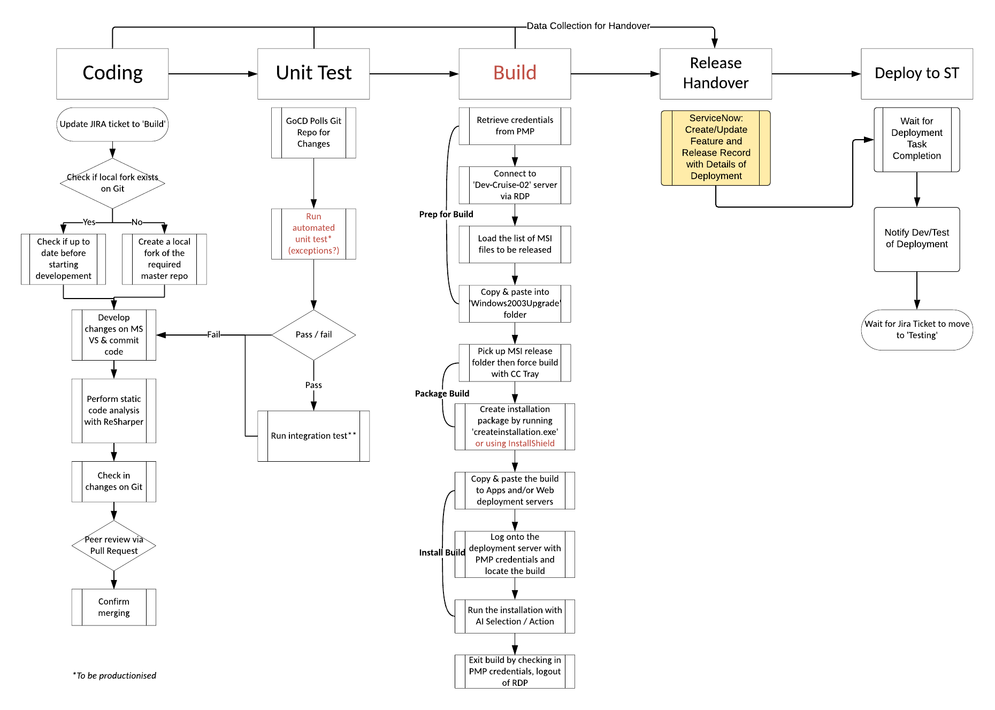
Bridge the Gap: Jira – ServiceNow

